Slide 1
Electricity Prices
Brynn Sloane

Slide 2
Table of Contents
Description
EDA
PDA
Development
Conclusion
References

Slide 3
Brief Description and Overview of task
System Marginal Price for Electricity (SMPEA). The goal is to forecast this price based on a variety of features such as forecasted wind production, system load, temperature, wind speed, and several other factors.
The electricity market operates based on supply and demand, with prices fluctuating depending on various factors, including the availability of resources (like wind or sunlight), the cost of fuel, and consumer demand. Efficient electricity management and pricing are crucial for ensuring reliable and affordable power for all sectors of society.

Slide 4
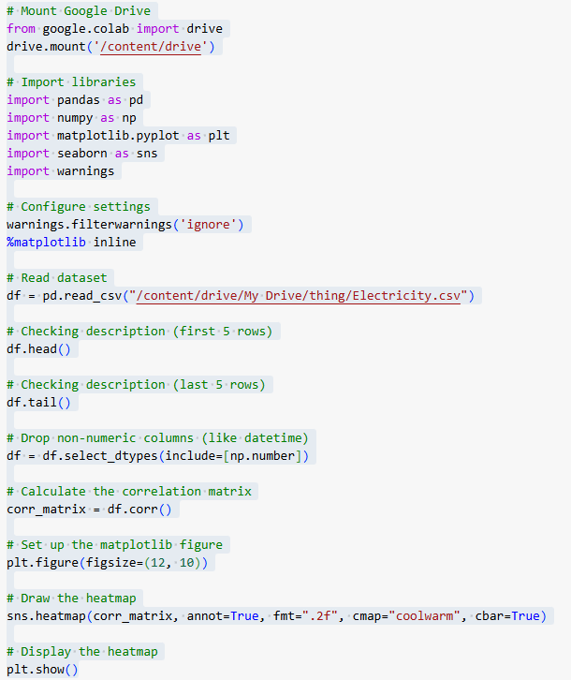
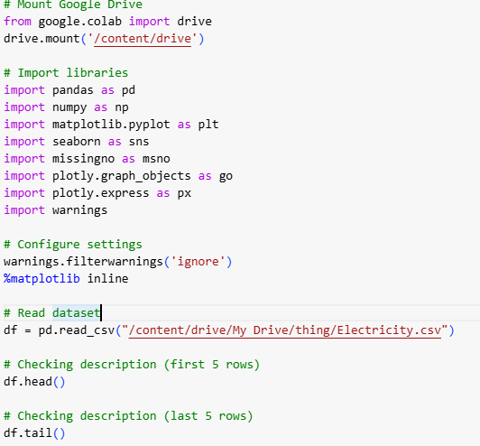
EDA (Exploratory Data Analysis)
Libraries used
Reading the Data Set
Creating Graphs

Slide 5
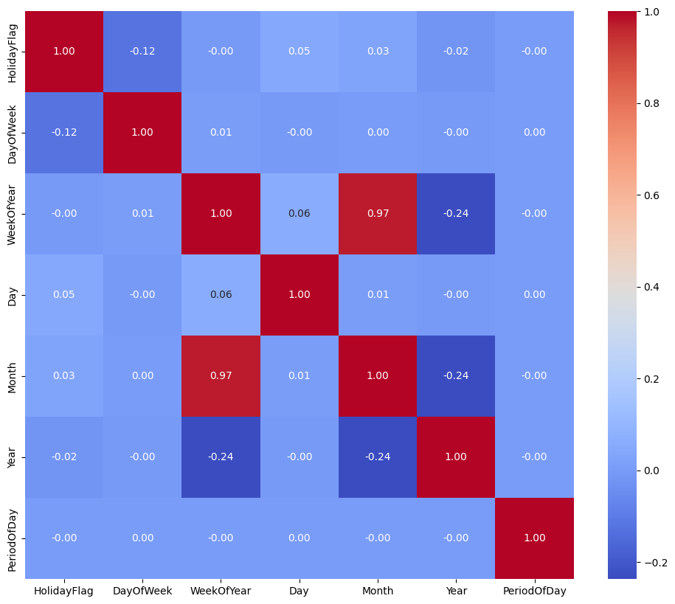
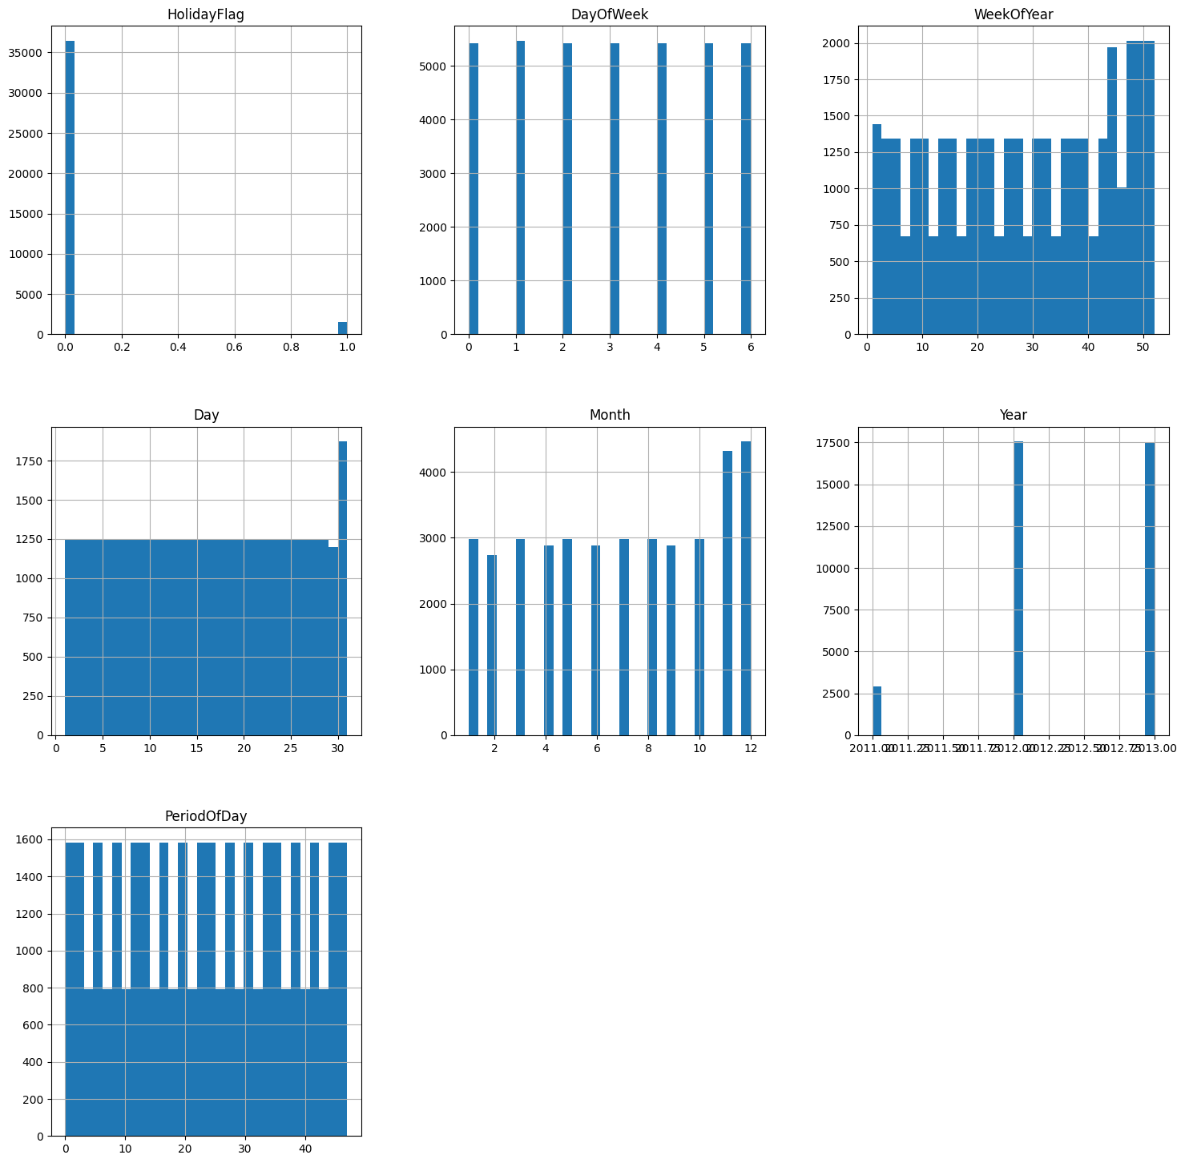
EDA Continued

Slide 6
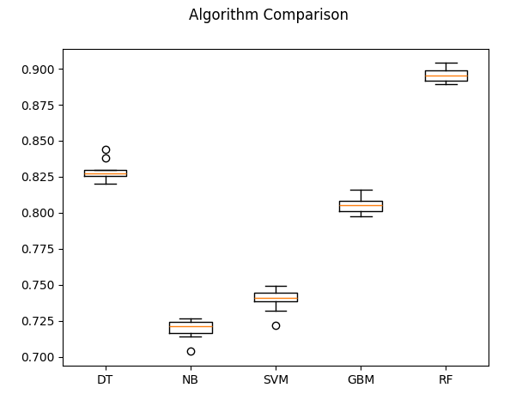
PDA
DT: 0.829174 (0.006578)
NB: 0.719641 (0.006485)
SVM: 0.739568 (0.007472)
GBM: 0.805432 (0.005250)
RF: 0.895597 (0.004806)
Steps Implemented
PreProcessing
Model Testing
Comparing Different Algorithms
Evaluating Each model/Comparing Performance
Confusion Matrix
Prediction Report

Slide 7
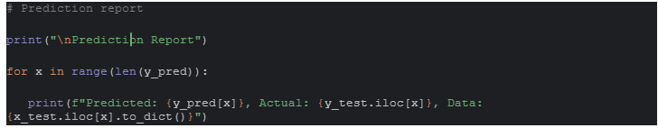
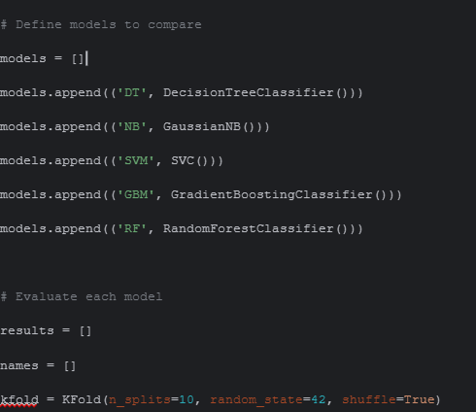
PDA Continued
# Compare algorithm performance
fig = plt.figure()
fig.suptitle('Algorithm Comparison')
ax = fig.add_subplot(111)
plt.boxplot(results)
ax.set_xticklabels(names)
plt.show()

Slide 8
Development of GUI
Tkinter Used to Create GUI
User Friendly Inputs
Grid system used

Slide 9
Conclusion

